Slide 1


Long Calderwood Primary
Standards and Quality report for 2023-2024

Slide 2

Welcome to Long Calderwood Primary
We are pleased to share with you our Standards and quality report for session 2023-24. This report highlights the work we have been doing to improve the quality of learning in our classrooms during 23/24. In this report you will find:
A description of our school
Our new vision and values
A progress report on our improvement priorities
Our next steps for 2024-25
Welcome to
Long Calderwood
Primary

Slide 3
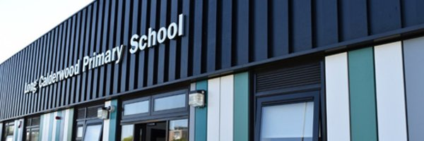
Long Calderwood is a non-denominational, co-educational school serving the Calderwood area of East Kilbride; the housing stock in Calderwood comprises social, private, and private let housing. The building provides a single level bright modern learning environment and a large play area with a 9-a-side 3G football pitch. We are currently developing the playground and courtyard classroom to provide facilities for learning outdoors. Our pupils enjoy the physical aspect of wellbeing and we run a range of extra-curricular activities and participate in numerous sporting events in this area.

Slide 4
Our new vision
To provide a nurturing and inclusive environment which enables everyone in the school community to build positive relationships and learn effectively

Slide 5
Our new values
Determination
Confidence
Respect
Kindness
Bravery
Trust

Slide 6

Our priorities for 23-24
Improve the play based curriculum in our early level class, P1.
Improve enquiry-based learning opportunities in first and second level of Curriculum for Excellence.
Improve teaching and learning in writing from P2-7
Improve wellbeing and being ready to learn through supporting children to explore and manage their emotions.
Improve teaching and learning in Sciences.

Slide 7


Slide 8
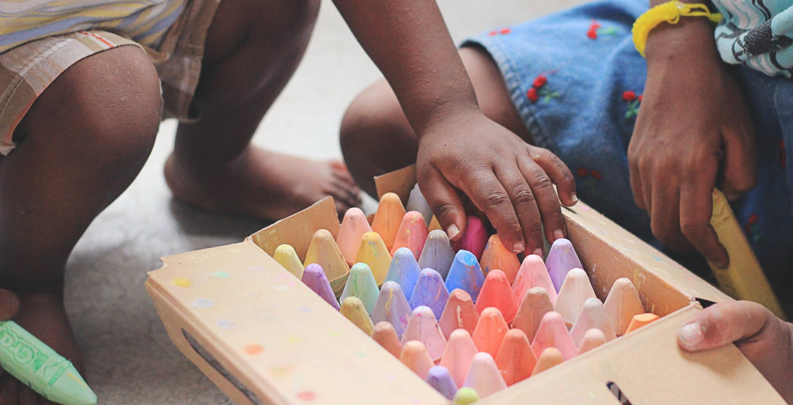
Progress with play in P1
Our P1 teacher successfully completed a professional learning course in play pedagogy and this training helped the teacher deepen her existing knowledge and implement organisational changes within the classroom.The creation of zones in the class enabled children to access free play throughout the day. Almost all pupils can now independently choose an area and demonstrate learning through play.
The P1 teacher regularly participated in professional dialogue with P2-3 colleagues and shared learning from the course. All infant staff now have an understanding of the changing approach in P1.
The teacher and support assistant observed pupils regularly and noted that over the course of the year most pupils showed an increased ability to independently further their own knowledge and skills. This involved the children selecting activities based on their own development needs. For example, when learning to write their names, pupils chose to practise this using a range of writing materials during play.
During the first few weeks of school, pupils were involved in a range of short thematic work which was focussed on play. This helped pupils to see that there was a wide scope for learning opportunities and that they were free to share their interests or get involved in contributing to the learning of the class.

Slide 9
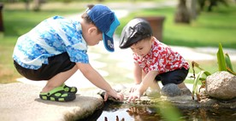
Progress with play in P1
In October, pupils were asked if they had any questions they wished answered or had anything they wanted to learn about. These ideas generated a list that was recorded in the floor book. These were then voted on by pupils and became the basis of topic learning for the year. Every child had input into this and subsequently when a topic of interest was presented, engagement levels within the class were high.
The implementation of the Teach, Target, Play approach enabled most pupils to understand the process in their learning. Short teacher input then led to a variety of learning activities that pupils could select based on their own interests. Those pupils requiring some additional teacher input, had targeted time with the teacher. The benefit of this was that pupils had choice in the trajectory of their learning and the class teacher had more time to specifically target those children requiring support.
It is clear that the implementation of Play Pedagogy in P1 has had a significant effect on the levels of engagement and enthusiasm for learning. Almost all pupils now have very good social interactions with their peers and adults within the classroom and this has had a positive effect on their learning. Pupils are confident to seek support from peers or adults when needed.

Slide 10

Progress with enquiry based learning
Teaching staff have improved their knowledge and understanding of the principles of enquiry based learning and most teachers are using this approach through ‘topic’ lessons and religious and moral education.
A few times a year, P3-7 are set a ‘Big Question’ and each class decide what they want to ‘take away’ from this learning by setting their own sub questions.
Topic wall displays are centered around the children being ‘Determined Detectives’ and displaying three big questions they want to answer.
There is an improvement in the pace of learning in contexts with each context running for 4-6 weeks.
Almost all teachers have introduced an assessment which checks the knowledge and understanding of the context meaning any misconceptions can be addressed before the end of the learning block.

Slide 11

Progress with writing
We have successfully raised awareness of the key features of explicitly teaching the literacy of writing and almost all staff are able to participate in staff dialogue to a high professional standard during moderation sessions The describing bubble has been accepted by all staff as a fundamental tool to aid learners write independent descriptions and is being used by the majority of teachers to aid writing in other text types.
All teachers have a basic understanding of how to model a writing lesson and have been given the opportunity to observe lessons delivered by more experienced practitioners. Class visits demonstrate that most teachers effectively use the pedagogy of modelling at the beginning of a new text type and are able to identify next steps in the gradual release of responsibility to meet the needs of the learners. Weekly overview planning shows that most teachers are able to describe the key features of the writing model and use this effectively to plan a series of lessons for each text type.
Overall attainment in writing has increased to across the school to 86% with a poverty related attainment gap of -3%.

Slide 12

Progress with wellbeing
All teachers have tracked pupil wellbeing and involvement using the Leuven Scale. This data has been monitored and universal and targeted support is provided to individuals with scores of 3 and below. There has been an improvement in pupil wellbeing, with the average well being score across the school increasing from 3.56 to 3.6. Although this increase is marginal, it indicates a positive trend in pupil wellbeing, demonstrating that targeted interventions and universal support strategies are beginning to take effect..
We implemented a 'Learning to Feel' Programme throughout the school and through each learning block we focused on a different emotion, linking it to real-life experiences for children. Teachers and support staff consistently used emotional vocabulary to help children understand and articulate their feelings. All staff have observed that most children can now accurately use this emotive vocabulary when describing their feelings and there has been a noticeable improvement in children's emotional resilience.

Slide 13
Progress with wellbeing
All classes have experienced lessons to promote a growth mindset and teachers have reported that these lessons have been effective, noting that pupils have engaged deeply with the content. Most children can now apply the vocabulary and approaches learned in various contexts of their learning, demonstrating the positive impact of this initiative.
All pupils in P4-7 have participated in Junior Activities for Schools Award. These activities, designed to enhance life and work skills, have effectively utilised both indoor and outdoor school spaces. Teachers have observed a high level of engagement, with almost all children participating enthusiastically in each activity. Additionally, there has been some improvement in peer relationships and collaboration among pupils.

Slide 14
Progress with wellbeing
We implemented several measures to support children to come to school ready to learn. These measures included promoting the breakfast club to ensure students start their day with a nutritious meal, providing all required stationery, offering access to spare school uniforms and PE kits, ensuring the availability of comfort and hygiene products, supplying healthy snacks, and introducing a soft start to the school day.
Class teachers have observed that pupils who require this additional support have significantly benefited from these initiatives. These efforts have led to improvements in school attendance, engagement, involvement in learning, and overall wellbeing for targeted pupils. Recognizing the success of these measures, the school aims to revise breakfast club activities and guidelines to encourage more children to attend. This initiative will be communicated to the entire school community, with increased engagement with targeted pupils. We also plan to incorporate pupil feedback to improve the breakfast club experience.

Slide 15
Progress with Sciences
This year we have identified a mentor who successfully analysed staff confidence and skills and used the information to plan a professional learning programme for the year.
Class teachers are now more confident in planning and delivering science lessons as a result of the mentor providing support through demonstration lessons, team teaching and classroom observations.
Valuable relationships have been built with staff within the learning community between heateachers and between mentors who network regularly and support each other.
Gender bias has been explored in a variety of ways including lessons and assemblies and resources have been purchased to support this. Most children and all staff are now aware that all genres can choose to follow any career path they wish.

Slide 16
Excellence and equity report
We implemented several measures to support children to come to school ready to learn. These measures included promoting the breakfast club to ensure a positive start to the day with a nutritious meal, providing all required stationery, offering access to spare school uniforms and PE kits, ensuring the availability of comfort and hygiene products, supplying healthy snacks, and introducing a soft start to the school day. Additionally, individual pupils have adapted timetables throughout the day to assist with transitions. These measures have greatly benefited targeted pupils, improving their attendance at school and in class.
Targeted support has led to increased Leuven scale scores, reflecting their enhanced engagement and ability to focus during learning. The nurture space in our school will continue to be available next academic session, ensuring ongoing support as needed. Targeted children identified for nurture show improved wellbeing, reduced barriers to learning, and can sustain longer periods in their mainstream classes.

Slide 17
Excellence and equity report
In numeracy and mathematics, 11 out of 13 targeted children are developing in most taught concepts and skills, with the remaining pupils making good progress and no longer requiring significant support and additional support and interventions have been implemented to address the needs of the other children. The gap analysis in numeracy has now decreased to -7% (figure based on the attainment of the current P2, P5 & S1)
In Literacy, we identified 20 children who could potentially be making very good progress in literacy, developing in most taught areas. We are pleased to report that 19 out of 20 of these pupils achieved this and no longer require significant support in this area. There is now no poverty related attainment gap in reading, writing nor listening and talking (based on the attainment of the current P2, P5 & S1).
The implementation of Play Pedagogy in P1 has had a significant effect on the levels of engagement and enthusiasm for learning in our targeted pupils and almost all now have very good social interactions with their peers and adults and this has had a positive effect on their learning. Pupils are confident to seek support from peers or adults when needed.

Slide 18
Excellence and equity report
Our efforts to improve attendance also showed promising results. There was noticeable improvement, with all seven pupils increasing their attendance from the previous year's figures, showing gains ranging from 2% to 14%. This improvement can be attributed to several key factors.
Frequent communication with parents and carers helped address and mitigate attendance issues.
Initiatives aimed at reducing the cost of the school day made it easier for families to ensure their children could attend school.
Following the South Lanarkshire Council staged intervention process for attendance, which provided a structured approach to addressing absenteeism.
Regular monitoring and reviewing of plans, along with the involvement of other agencies, offered comprehensive support to the targeted pupils.

Slide 19


Slide 20

What are we going to do now?
Improve the play curriculum in P2
Further improve writing by linking to the texts used in the reading programme
Improve relationships between peers
Further improve the teaching and learning experiences in Sciences and Technologies
Continue to monitor the poverty related attainment gap and provide universal and targeted support for targeted children.

